Slide 1
Pick it! Try it! Like it!
Fruit and vegetable information

Slide 2
Full page flyers on 43 different fruits and vegetables http://igrow.org/healthy-families/health-and-wellness/pick-it-try-it-like-it/

Slide 3
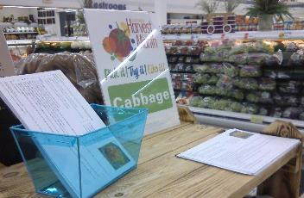
Pick it! Try it! Like it! includes:
Fruit and vegetable information cards or tear pads
Grocery store signage
Promethean lessons for 5th-12th grades
Sampling instructions for demonstrations or distribution
Created by

Slide 4
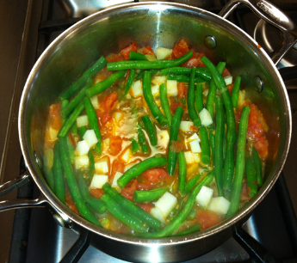
Recipes and video components
Pick it! Try it! Like it!
Ingredients list
Simple instructions plus visuals
Also available as a looping slide show
https://www.youtube.com/watch?v=cqU_OVR8kVU&feature=youtu.be

Slide 5
Recipe/Information Card
Simple and healthy
Low cost
Mostly taste the fruit/veggie

Slide 6
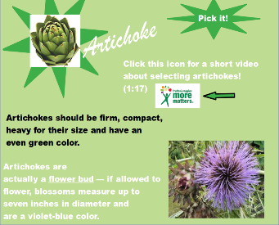
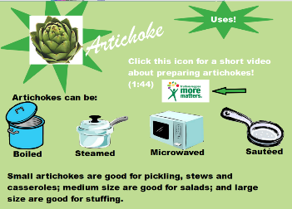
Interactive Promethean or SmartBoard files for upper elementary/ middle school.
Available from karlys.wells@sdstate.edu

Slide 7
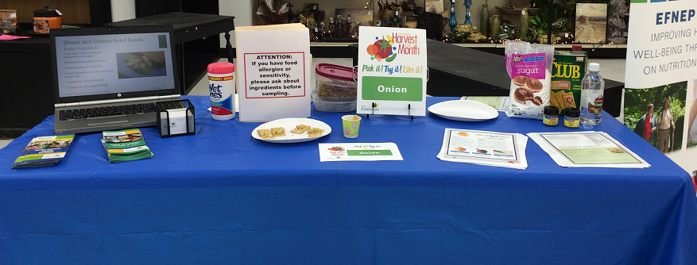
Implementations
Pick it! Try it! Like it!
Monthly produce sampling stations at grocery stores
Teat pads in produce departments (with and without a Harvest of the Month mini-grant agency partner)
Farmer’s markets
WIC offices
Food & Families Facebook
Meals on Wheels/Senior Meals
Dept. of Social Services food packages (not sure of correct name)

Slide 8
SD Harvest of the Month (HOM)
Lessons online for preschool through 5th grade and after school programs at http://www.sdharvestofthemonth.org/
Search by food or by season
Originally California Nutrition Network “Harvest of the Month” SNAP-Ed program modified for SD by the SD Discovery Center, Pierre

Slide 9
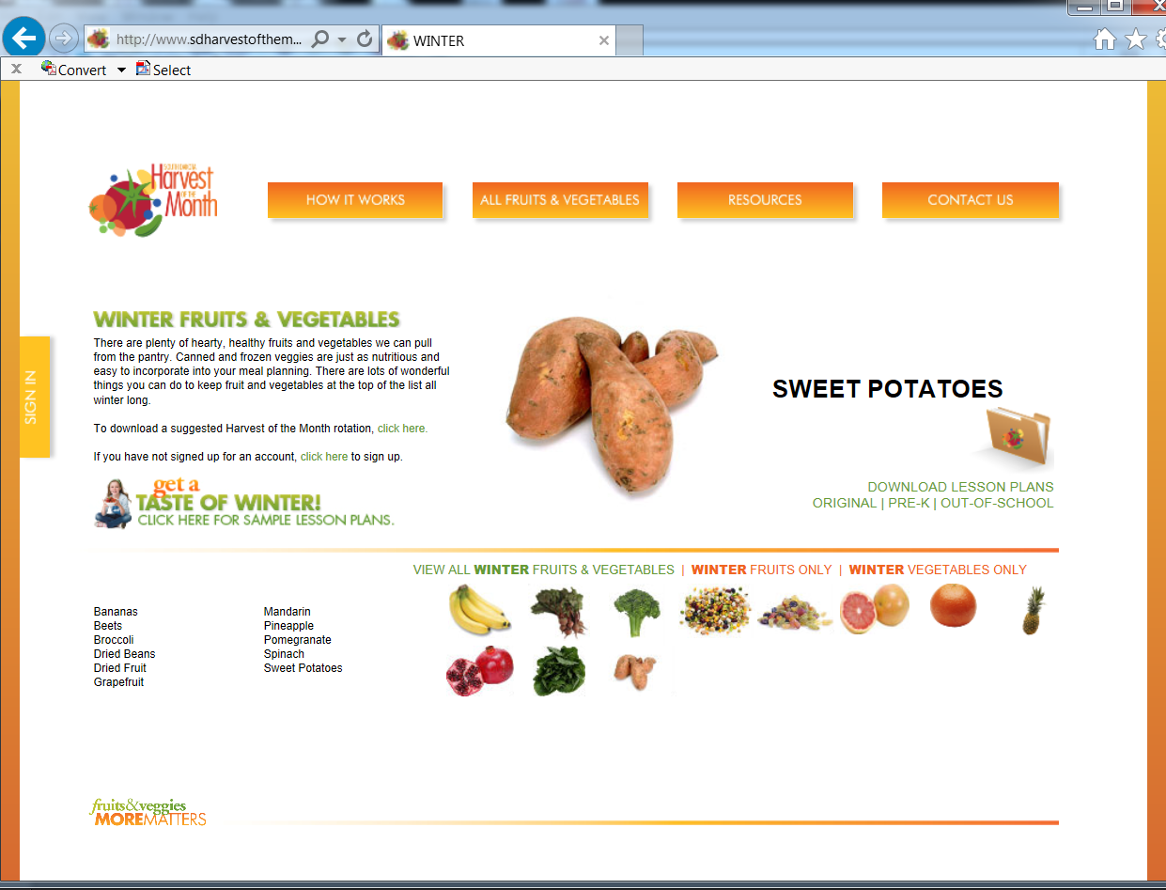
Includes
teaching PowerPoint
teaching notes
student note-taking sheet
parent newsletter with recipes

Slide 10
USDA mini-grants support HOM and Pick it. Try it. Like it.
Funds to help schools and child care sites
Teach Harvest of the Month lessons
Include monthly tasting experiences
Include a local grocery store as partner
Place matching Pick it. Try it. Like it. materials in produce sections
Include farmers’ markets
Funding from USDA Team Nutrition through the SD Department of Education/Child & Adult Nutrition Services and SD Department of Health

Slide 11
Harvest of the Month Mini-grants for youth education
$125 to $400 amounts until August 30, 2016
Agencies affiliated with National School Lunch Program
Series of 4 fruit and 4 vegetables lessons and tasting experiences
Apply online http://doe.sd.gov/cans/teamnutrition.aspx

Slide 12
PTL Research
100% of the grocers and farmer’s markets would utilize the program again
Descriptive, well designed, professional and colorful
Increased sales in 7 of 12 grocery stores and 3 of 12 farmer’s markets
Informative and recipes valuable
Increased owner’s personal knowledge of nutrition
Caught customer’s attention and sometimes led customers to look for the product
Educated customers especially on the less common produce items

Slide 13
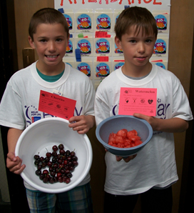
HOM Results
Fruit and vegetable knowledge increased among children
Post-intervention, children were less likely to be in the ‘low’ fruit and vegetable consumption groups and more likely to be in the ‘high’ consumption groups

Slide 14
Harvest of the Month in the Home
76% of caregivers indicated their child had mentioned HOM
Over 55% of caregivers indicated that they used the HOM handouts brought home by children
Many caregivers indicated that over the past 6 months, their child asked for more fruits and vegetables (72%) and their child seemed more willing to taste or eat fruits and vegetables (83%)

